Slide 1
AZ-104 Readiness Quiz

Slide 2
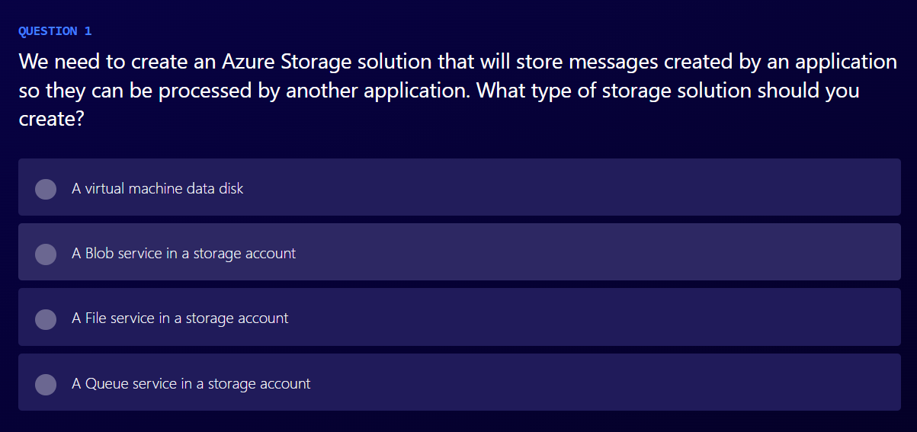

Slide 3
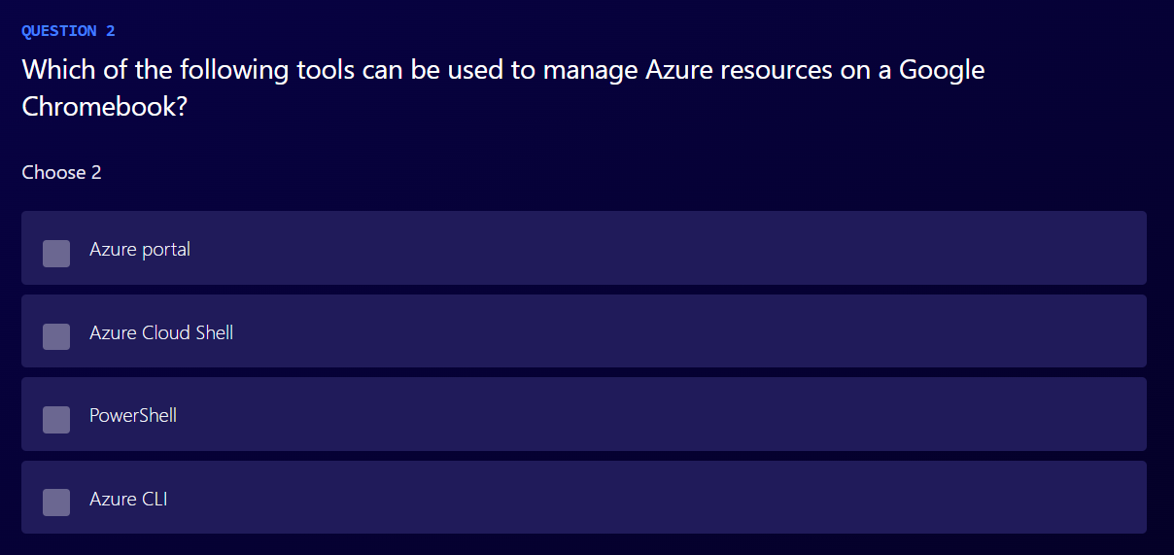

Slide 4
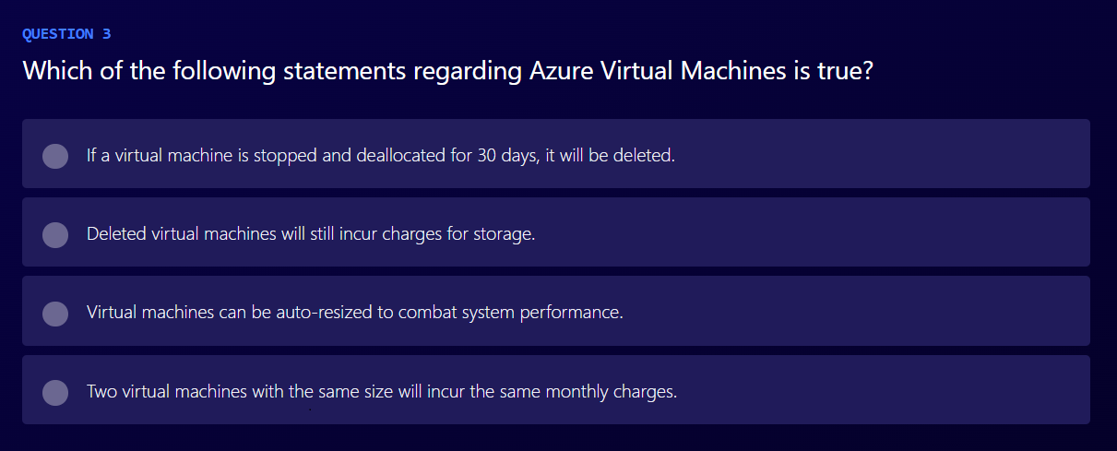

Slide 5
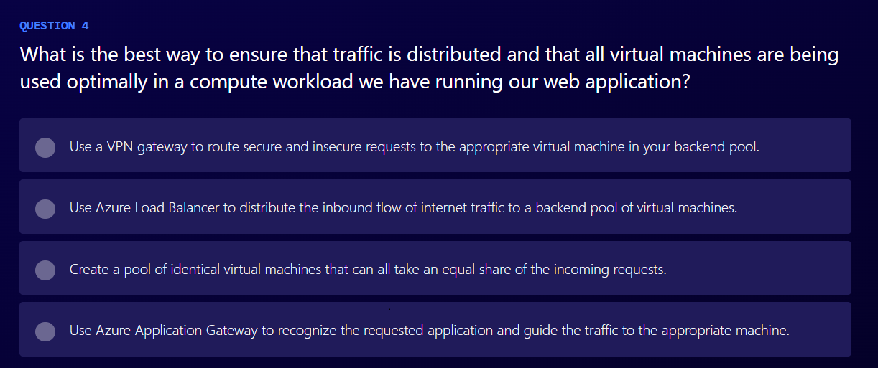

Slide 6
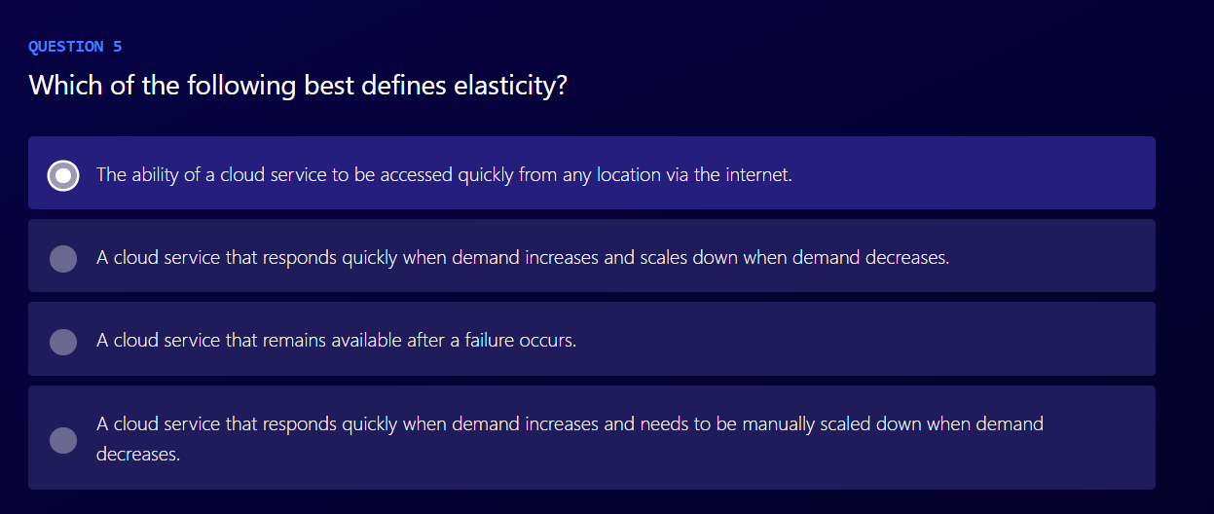

Slide 7
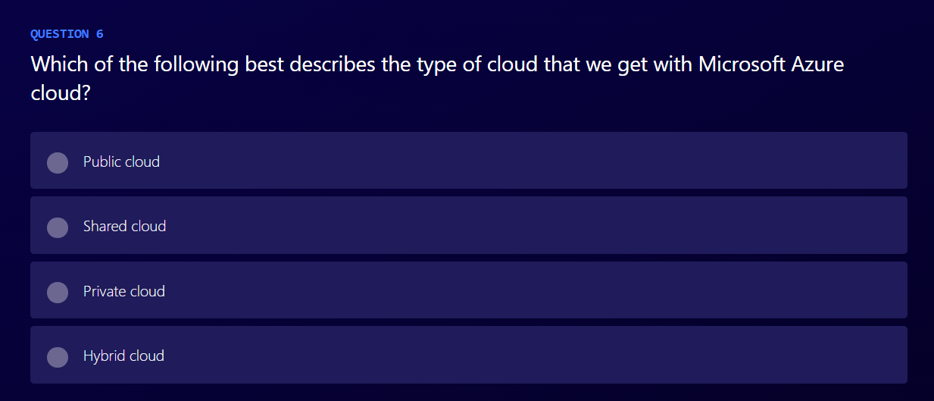

Slide 8
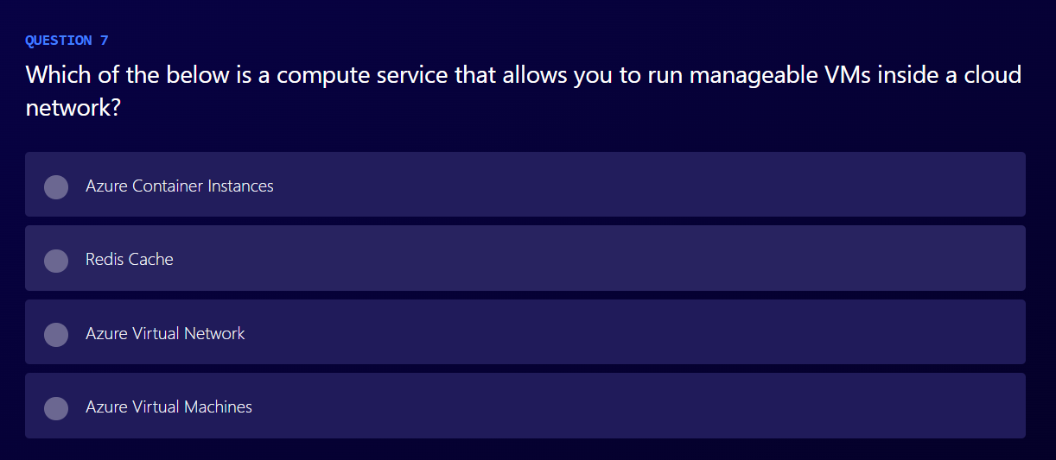

Slide 9
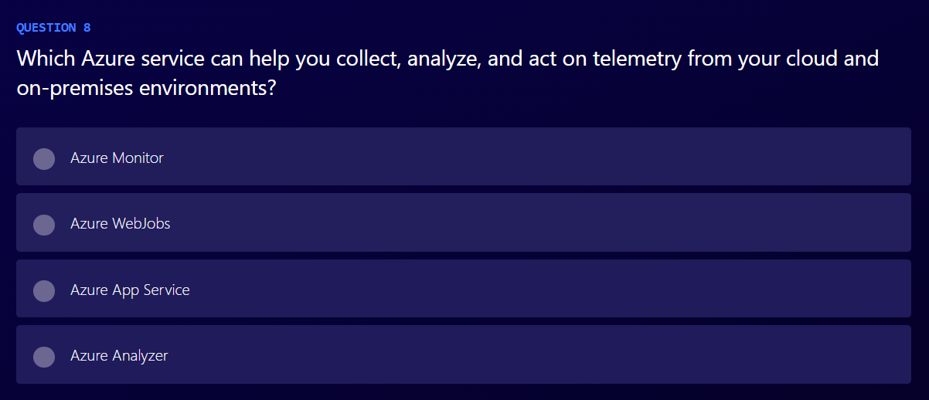

Slide 10
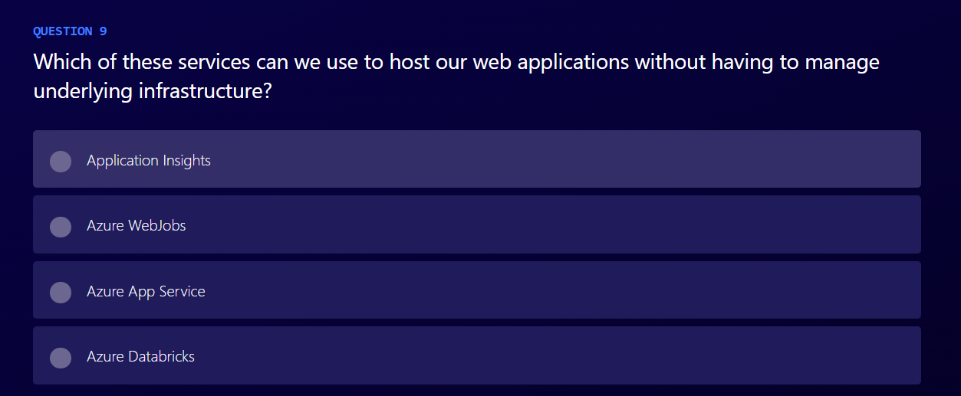

Slide 11
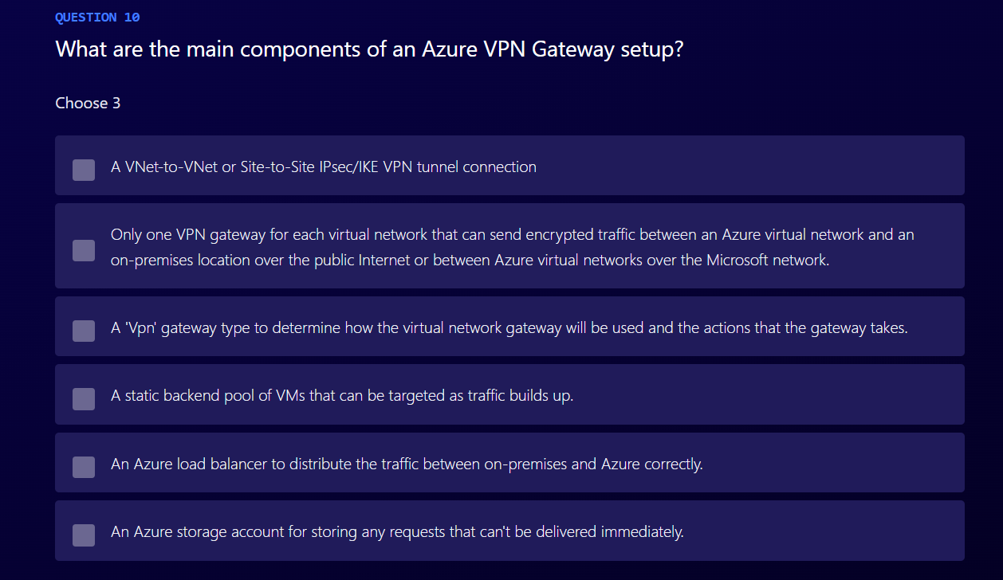

Slide 12
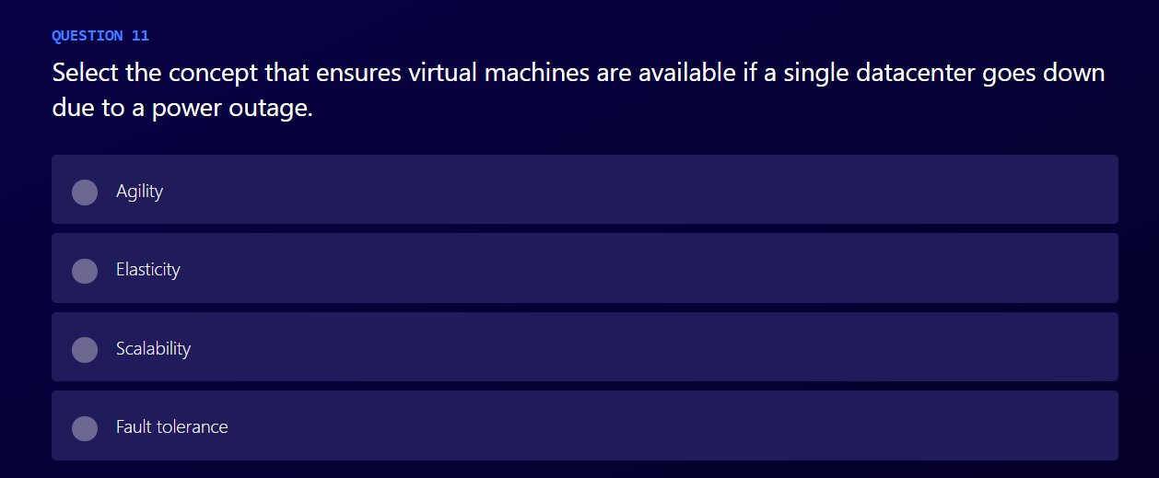

Slide 13
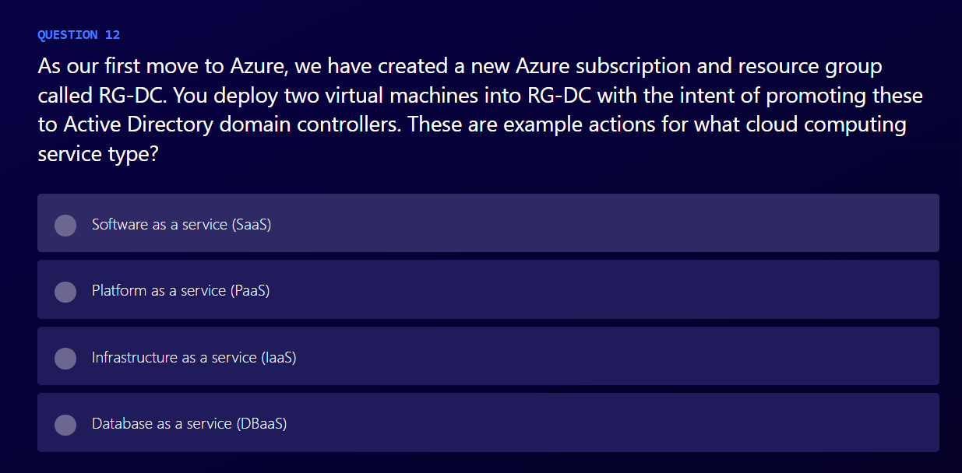

Slide 14
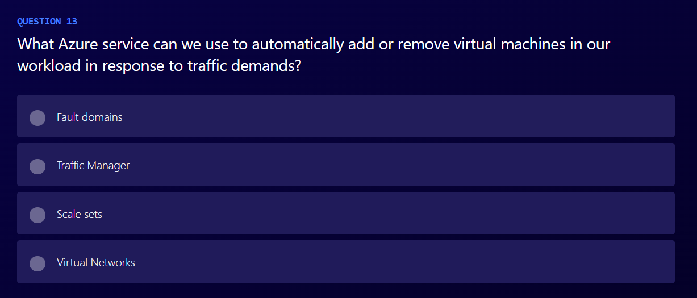

Slide 15
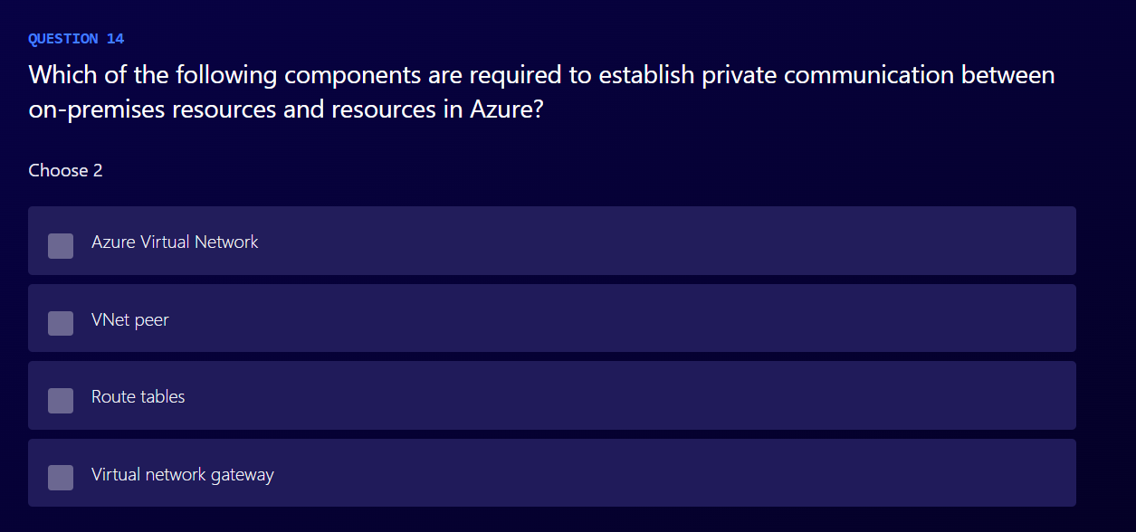

Slide 16
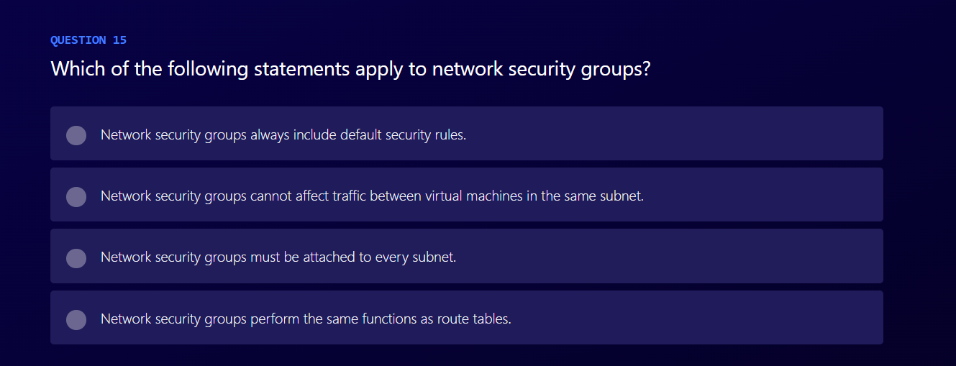

Slide 17
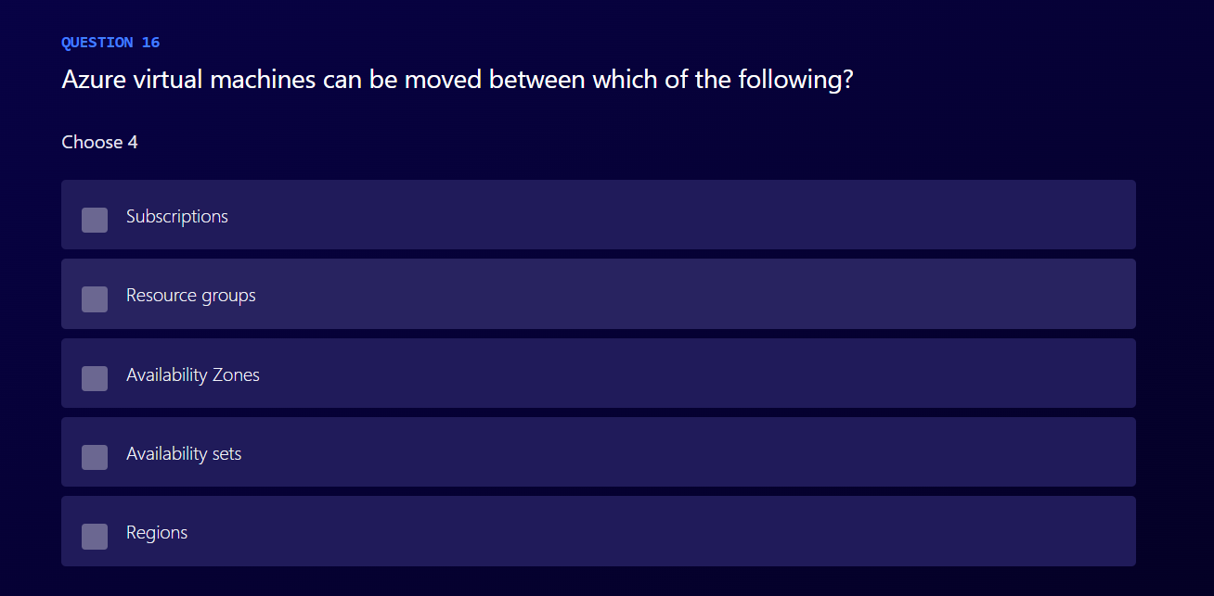

Slide 18
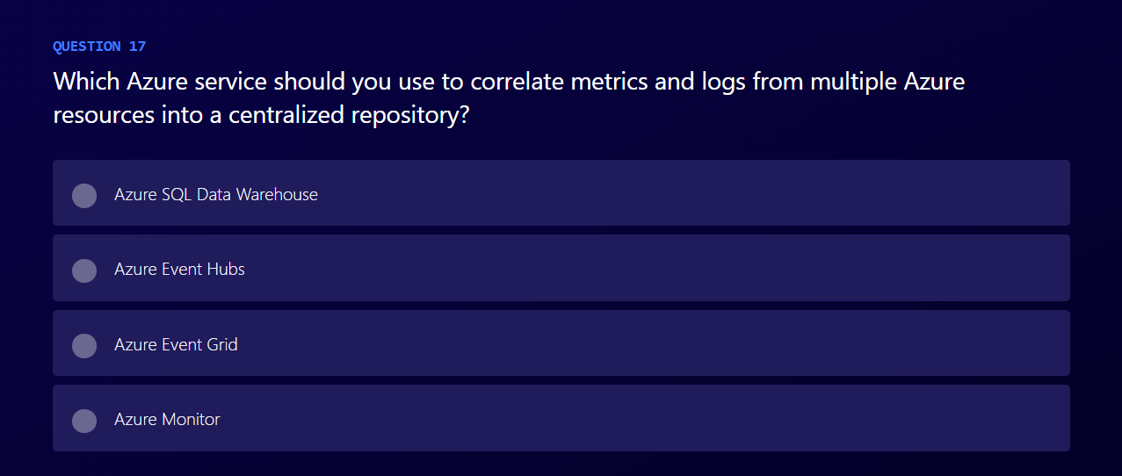

Slide 19
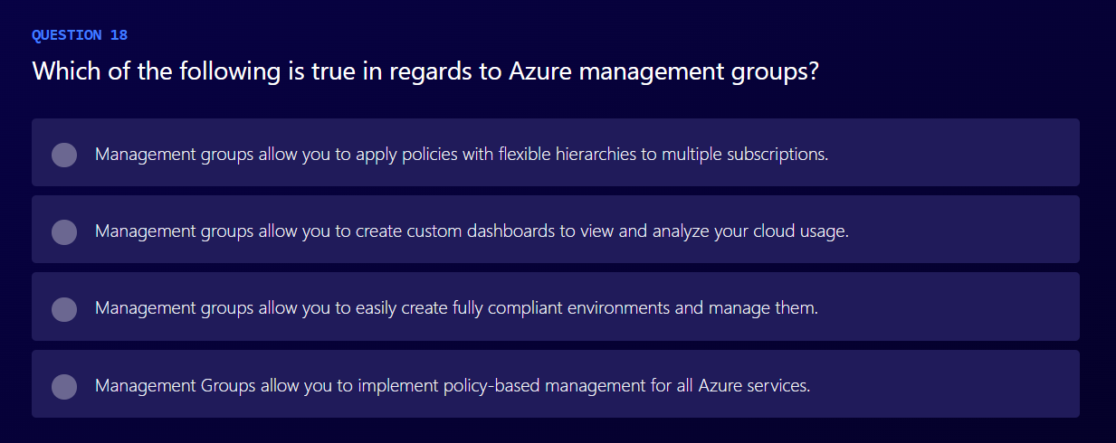

Slide 20
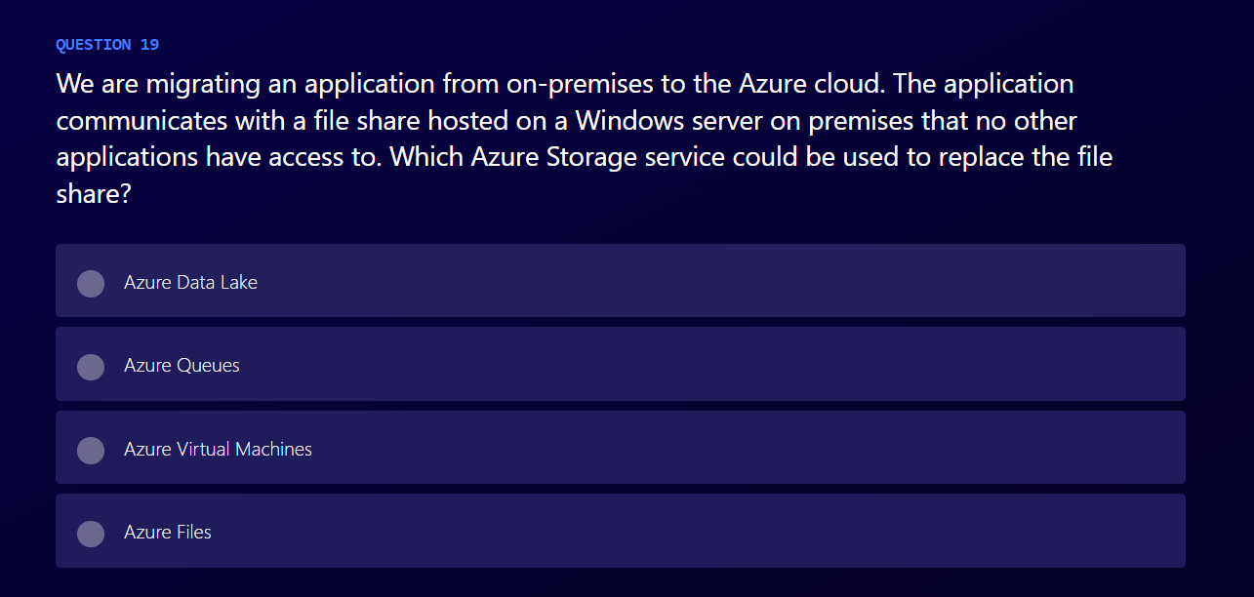

Slide 21
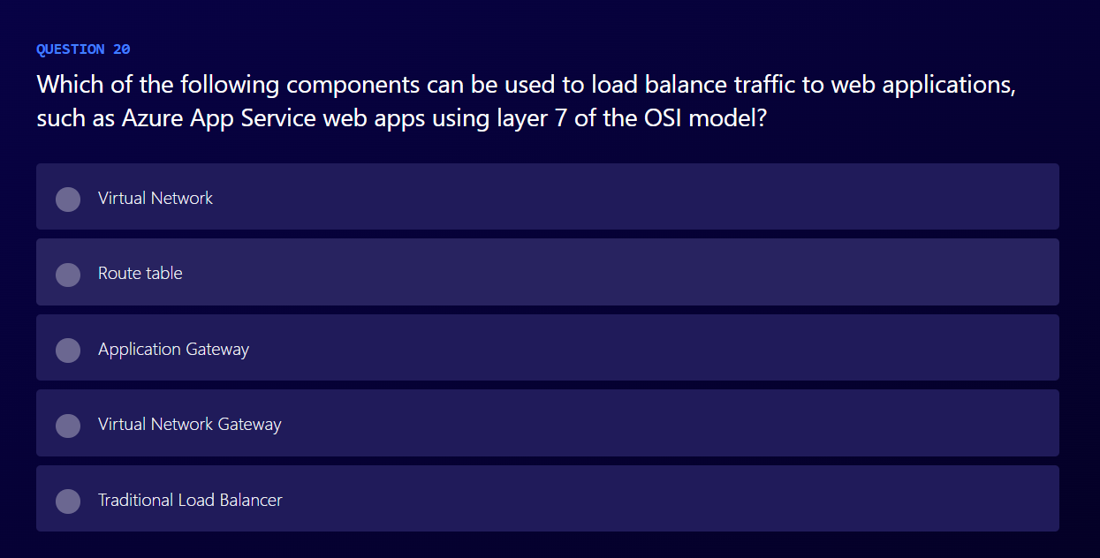

Slide 22
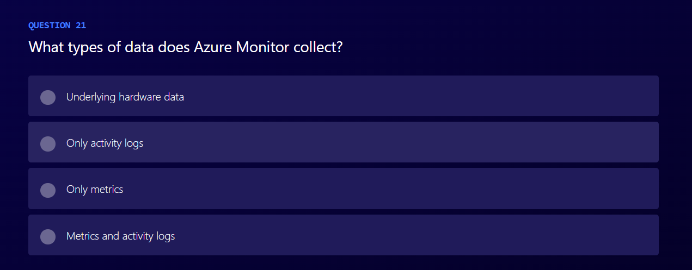

Slide 23
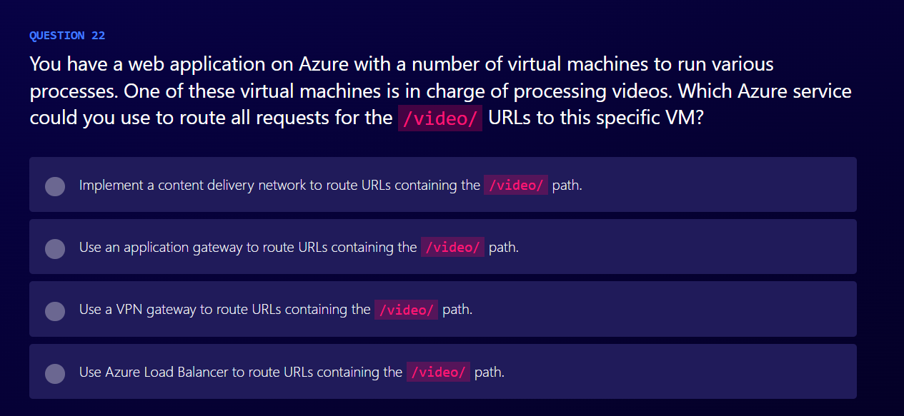

Slide 24
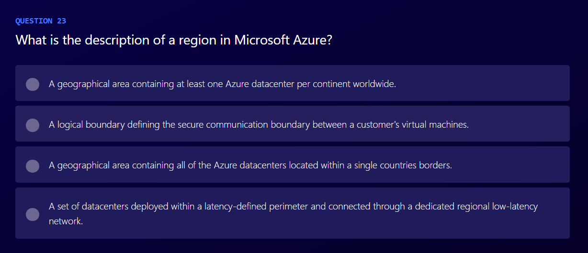

Slide 25
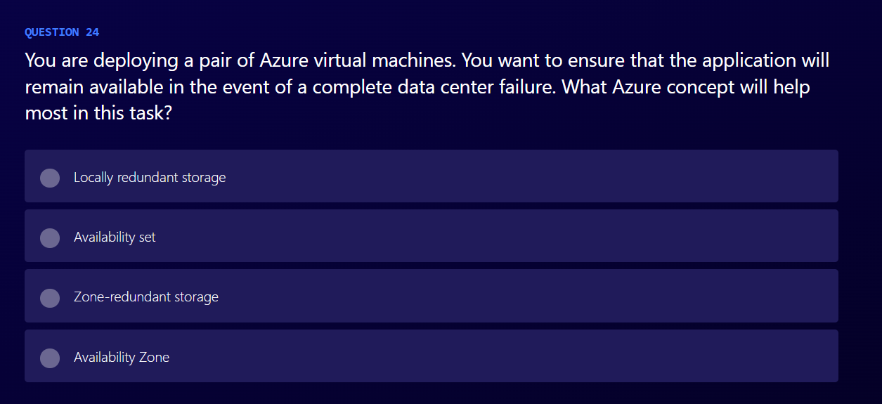

Slide 26
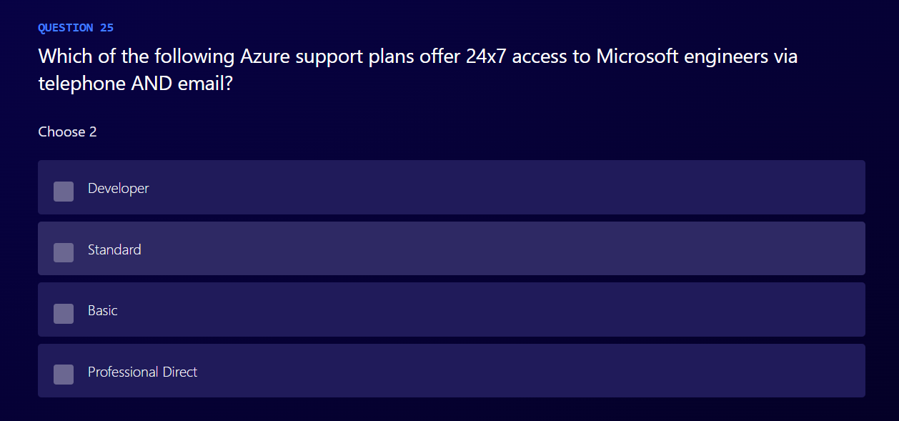

Slide 27
Answers

Slide 28
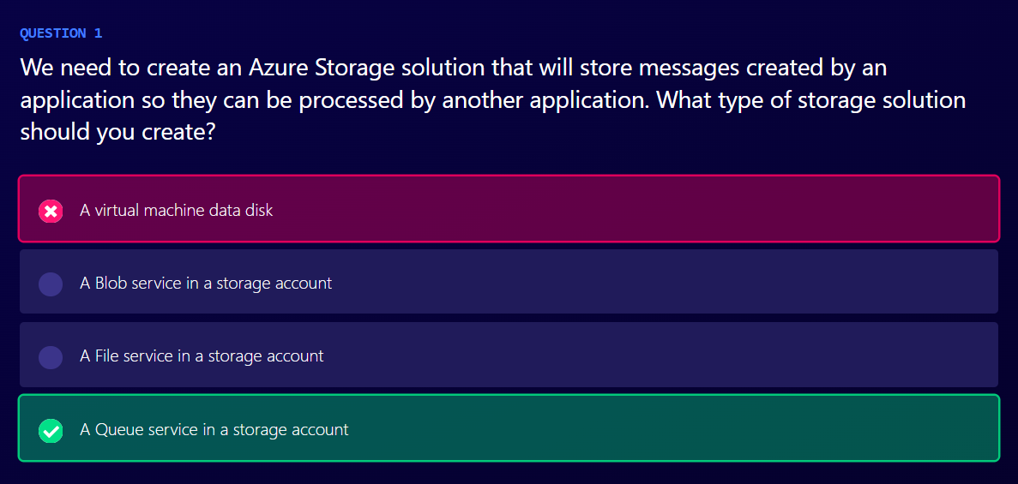
Notes:
Azure Queue Storage is a service for storing large numbers of messages that can be accessed from anywhere in the world via authenticated calls using HTTP or HTTPS.
https://docs.microsoft.com/en-us/azure/storage/queues/storage-queues-introduction

Slide 29
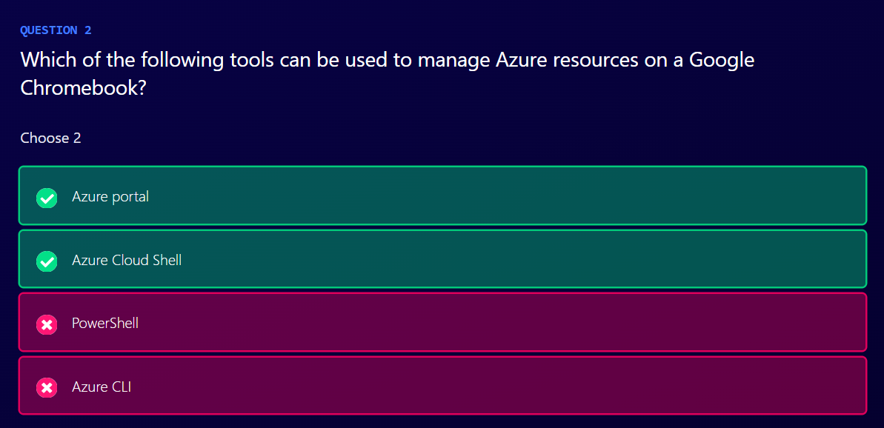
Notes:
Azure portal is a web application that is accessible on all modern desktop, tablet devices, and browsers. As long as your device can run a modern web browser, you can generally use the Azure portal.
Azure Cloud Shell is an interactive, browser-accessible shell for managing Azure resources. It provides the flexibility of choosing the shell experience that best suits the way you work. Linux users can opt for a Bash experience, while Windows users can opt for PowerShell. At this time, there is no native PowerShell Core distribution for Google OS, and the current version of the CLI cannot be installed on Google OS.

Slide 30
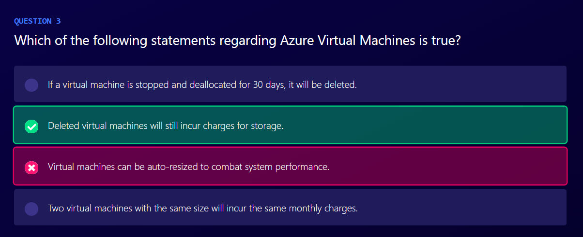
Notes:
When a virtual machine is deleted, its managed disk remains in the Azure portal and can be used to create a new virtual machine. Until this disk is manually removed, you will incur charges for the disk whether it is in use or not.

Slide 31
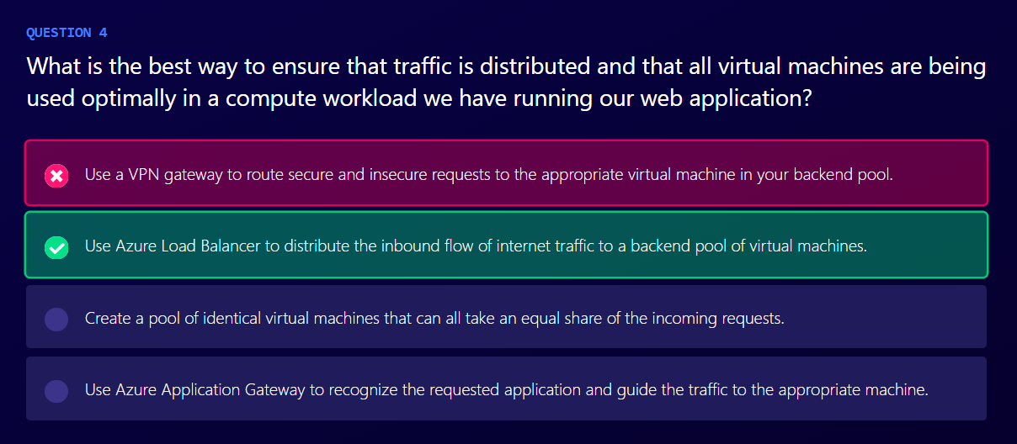
Notes:
Azure Load Balancer is used to distribute all incoming requests to a web endpoint and guide those requests to an instance in a backend pool of servers. Application Gateway is used to route traffic to specific VMs based on traffic properties such as the URL. A VPN gateway is used to link Azure and your on-premises account securely as if on the same network.

Slide 32
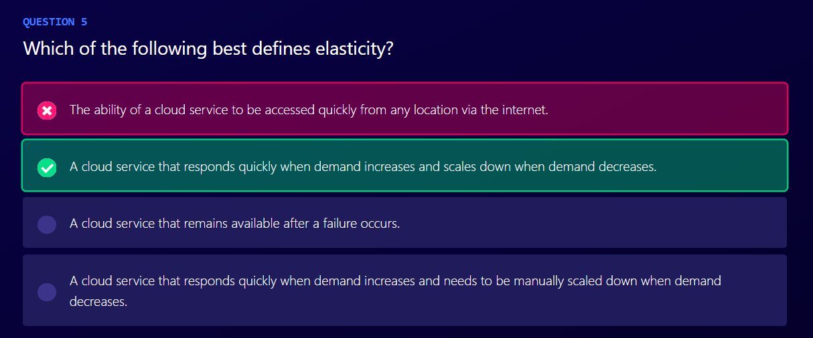
Notes:
Elasticity is defined as a cloud service that both quickly scales up and also back down in order to serve your changing workload patterns for the lowest cost.

Slide 33
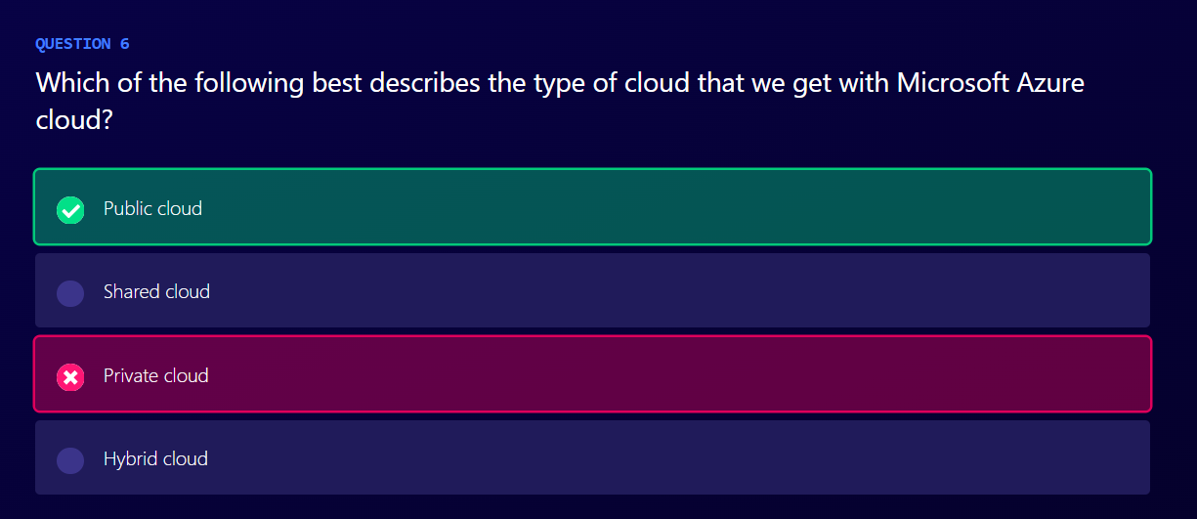
Notes:
Microsoft Azure is best described as a public cloud provider, since nearly anybody can provision services on Microsoft Azure if they have an account on the platform. This is the same as other major public cloud providers like AWS and Google Cloud Platform.

Slide 34
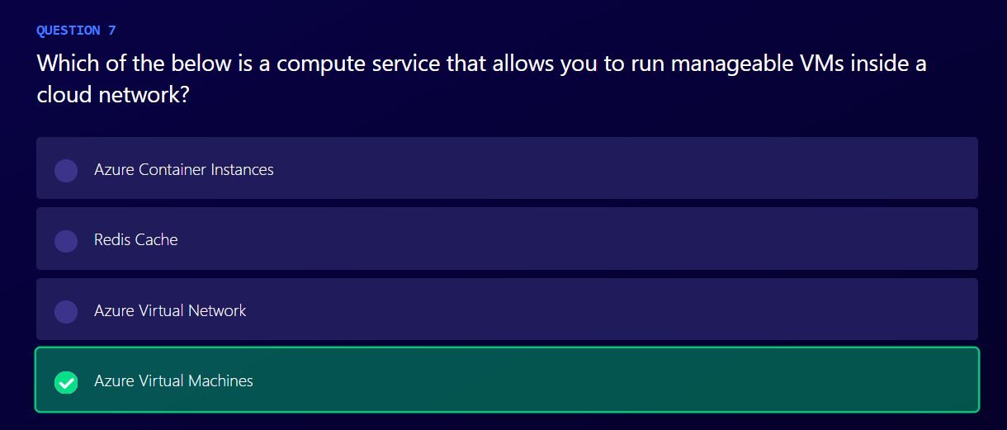
Notes:
Azure Virtual Machines is a compute service that allows you to run virtual machines in the cloud.

Slide 35
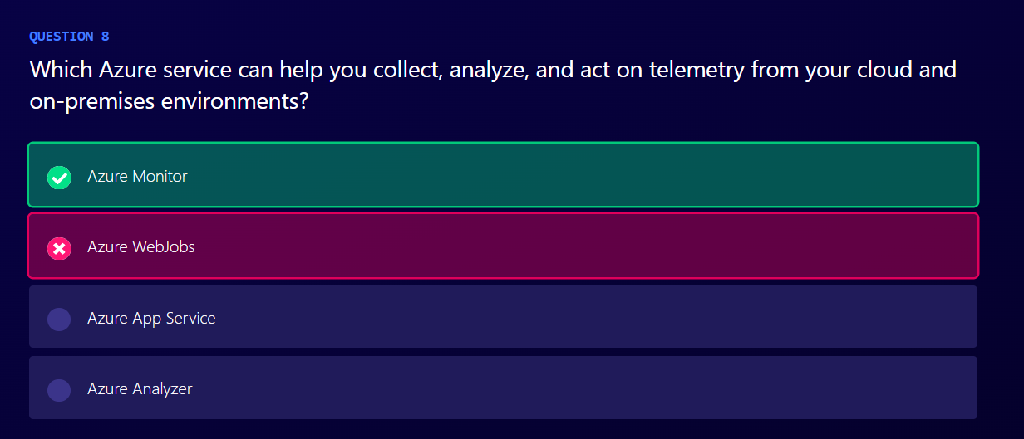
Notes:
Azure Monitor is a service that can help you understand how your applications are performing and proactively identify issues affecting them and the resources they depend on.

Slide 36
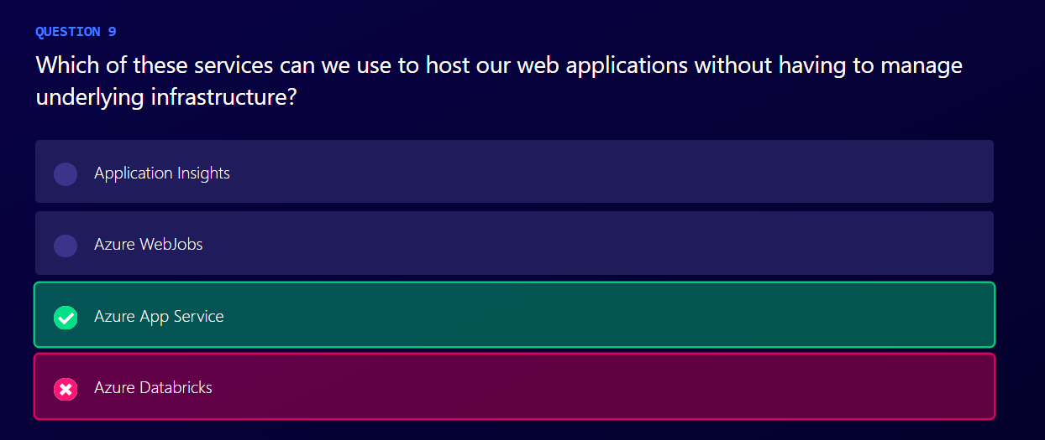
Notes:
Azure App Service enables you to build and host web apps, mobile backends, and RESTful APIs in the programming language of your choice without managing infrastructure. Azure App Service documentation - Azure App Service | Microsoft Docs:
https://docs.microsoft.com/en-us/azure/app-service/

Slide 37
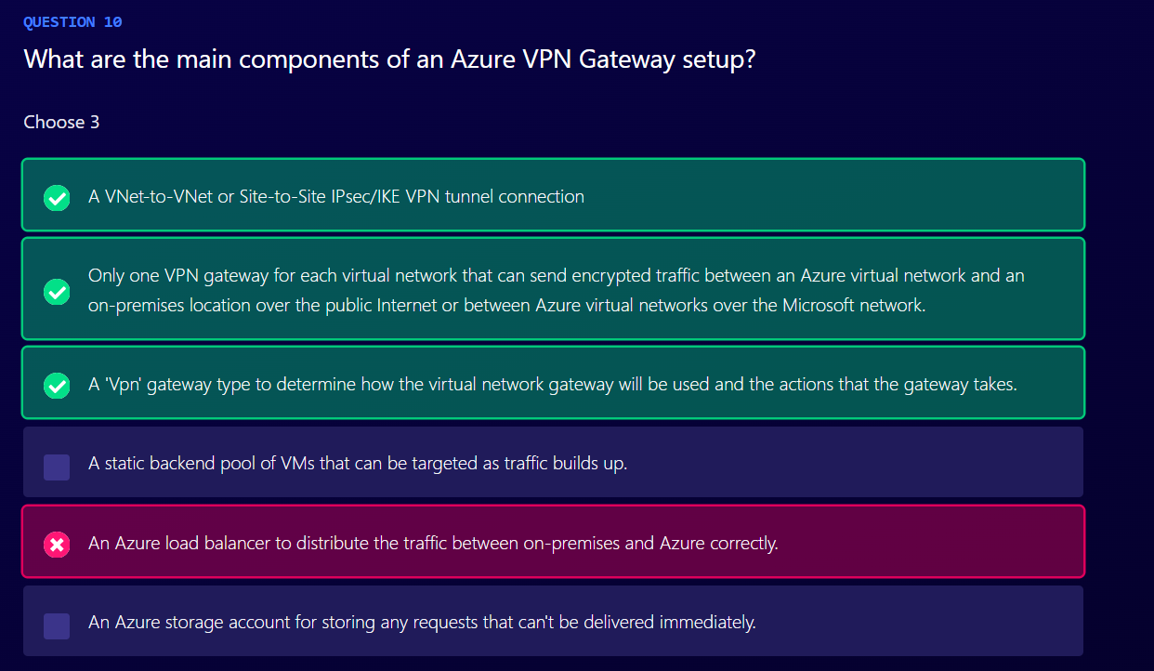
Notes:
After you create a VPN gateway, you can create an IPsec/IKE VPN tunnel connection between that VPN gateway and another VPN gateway (VNet-to-VNet), or create a cross-premises IPsec/IKE VPN tunnel connection between the VPN gateway and an on-premises VPN device (Site-to-Site).
A VPN gateway is a specific type of virtual network gateway that is used to send encrypted traffic between an Azure virtual network and an on-premises location over the public Internet. You can also use a VPN gateway to send encrypted traffic between Azure virtual networks over the Microsoft network. Each virtual network can have only one VPN gateway. However, you can create multiple connections to the same VPN gateway. When you create multiple connections to the same VPN gateway, all VPN tunnels share the available gateway bandwidth.
When you configure a virtual network gateway, you configure a setting that specifies the gateway type. The gateway type determines how the virtual network gateway will be used and the actions that the gateway takes. The gateway type 'Vpn' specifies that the type of virtual network gateway created is a 'VPN gateway'.

Slide 38
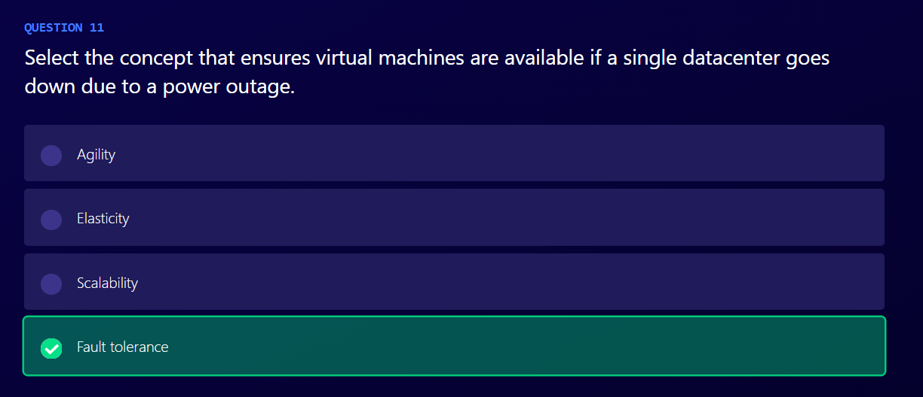
Notes:
Fault tolerance is the property that enables a system to continue operating properly in the event of the failure of one or more of its components. In Azure, it refers to ensuring that a portion of the production systems are available online (via a failover cluster, availability set, or Availability Zone) if a subset of the system components (or an entire datacenter) goes offline. Scalability is the ability of a system or network to handle an increased load. Elasticity refers to the ability to quickly expand or decrease computer processing, memory, and storage resources to meet changing demands without worrying about capacity planning and engineering for peak usage. Think of it as scalability with the ability to shrink processing power as well: https://azure.microsoft.com/en-us/overview/what-is-elastic-computing Agility is the ability of a business to adapt rapidly and cost efficiently in response to changes in the business environment.

Slide 39
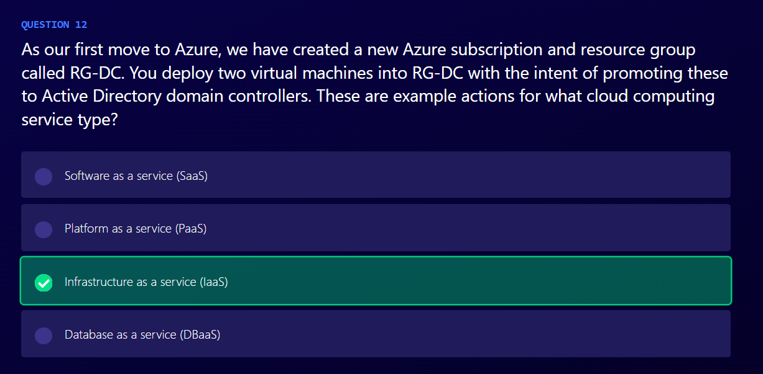
Notes:
Infrastructure as a service (IaaS) is the use of on-demand computing infrastructure provisioned and managed over the internet. Deploying virtual machines into an Azure subscription would be considered an IaaS service.

Slide 40
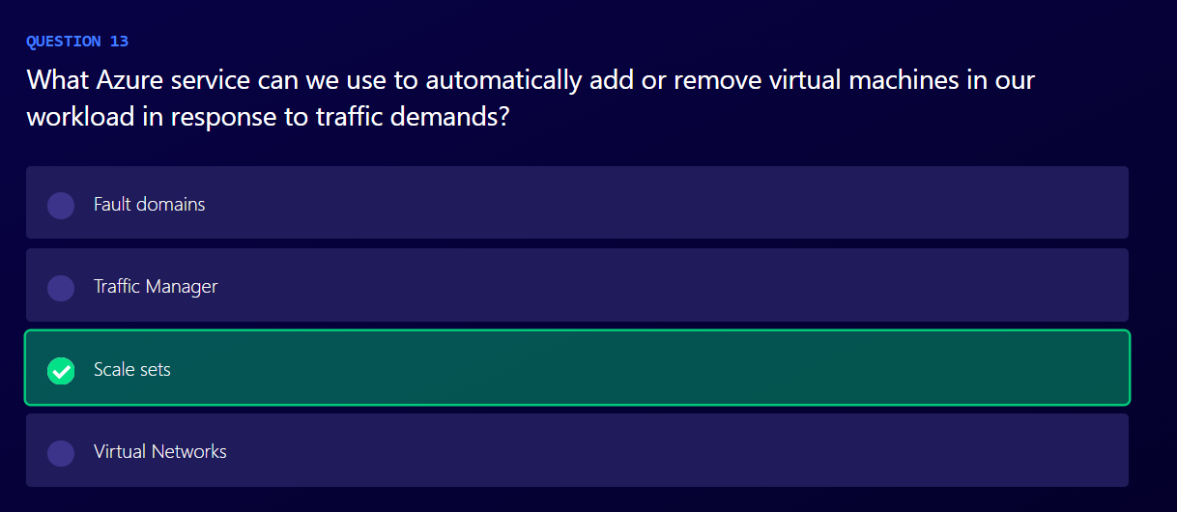
Notes:
cale sets will allow automatic scaling of virtual machines residing behind a load balancer, based on metrics which you specify. Virtual networks are used to provide network connectivity for virtual machines but cannot provide scaling. Fault domains are defined sections of Azure datacenters that utilize separate power, heating, ventilation, air conditioning, and top-of-rack switching from other fault domains, ensuring outages are contained within the specific fault domain. Finally, update domains ensure protection against two servers running similar workloads, or their underlying hypervisors being patched and taken offline at the same time.

Slide 41
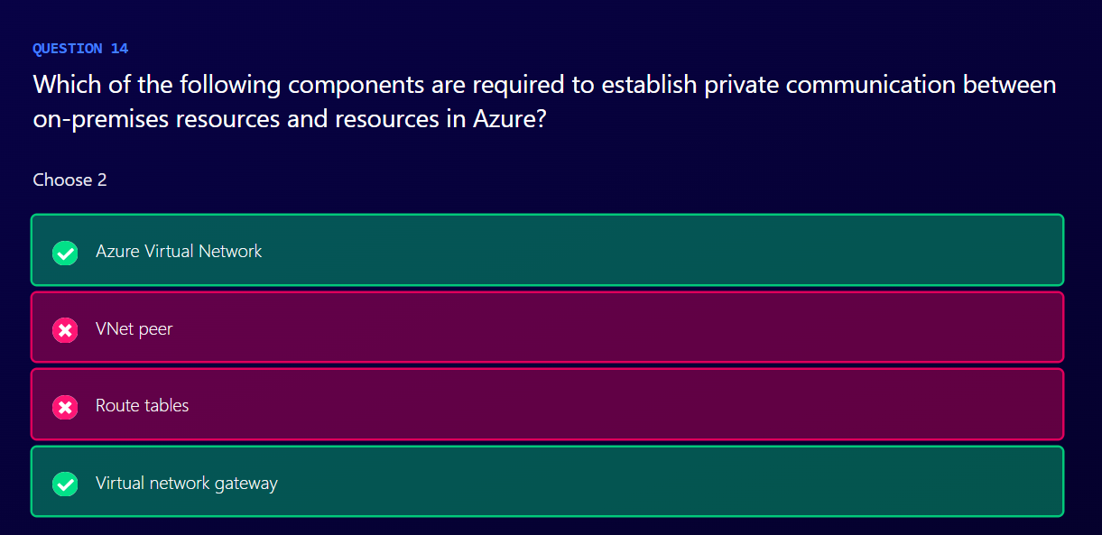
Notes:
Azure Virtual Network enables many types of Azure resources, such as Azure virtual machines (VMs), to securely communicate with each other, the internet, and on-premises networks.
A virtual network gateway defines the Azure network side of a site-to-site virtual private network.

Slide 42
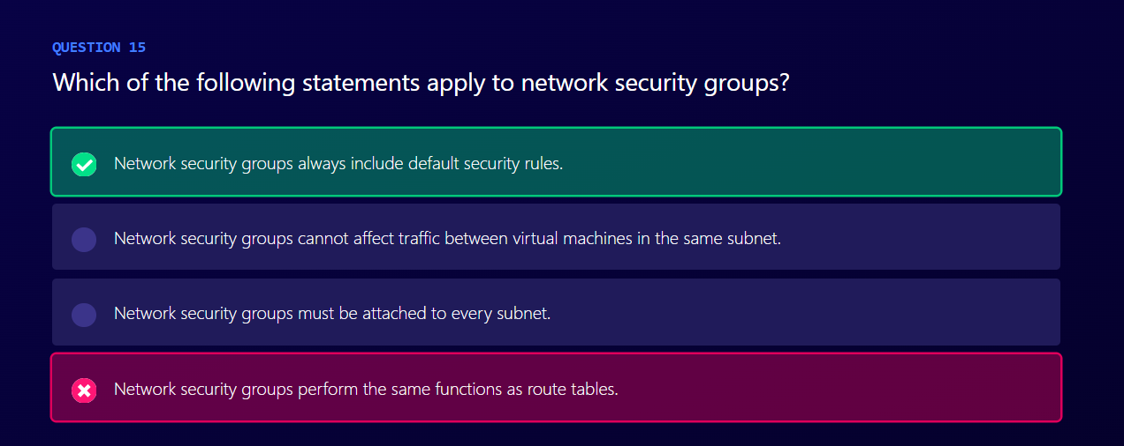
Notes:
Network security groups always include default security rules. These can be de-prioritized, but not deleted. Network security groups can be used to limit traffic between virtual machines in the same subnet and do not perform the same functions as route tables. They are not required to be attached to every subnet.

Slide 43
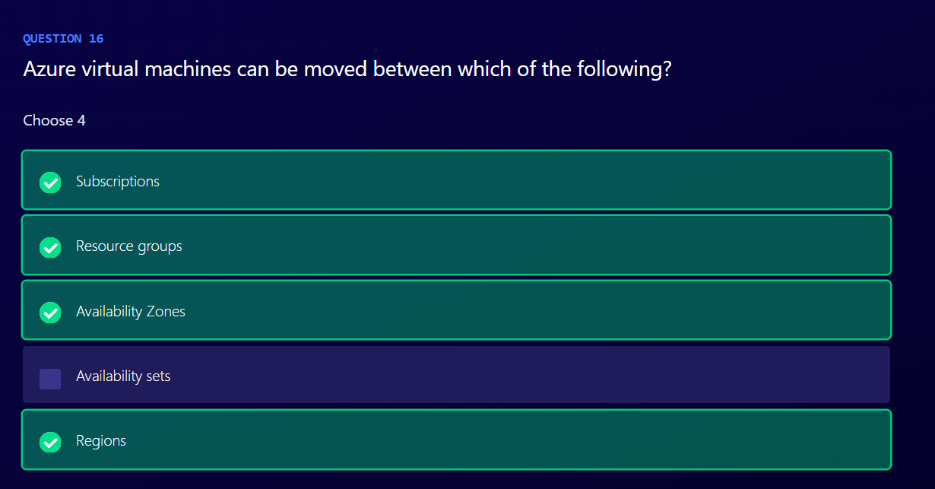
Notes:
Azure virtual machines can be moved between subscriptions with either Azure PowerShell or the Azure portal.
Azure virtual machines can be moved between resource groups with either Azure PowerShell or the Azure portal.
Using Azure Site Recovery, you can migrate Azure VMs to other Availability Zones.
Using Azure Site Recovery, you can migrate Azure VMs to other regions.

Slide 44
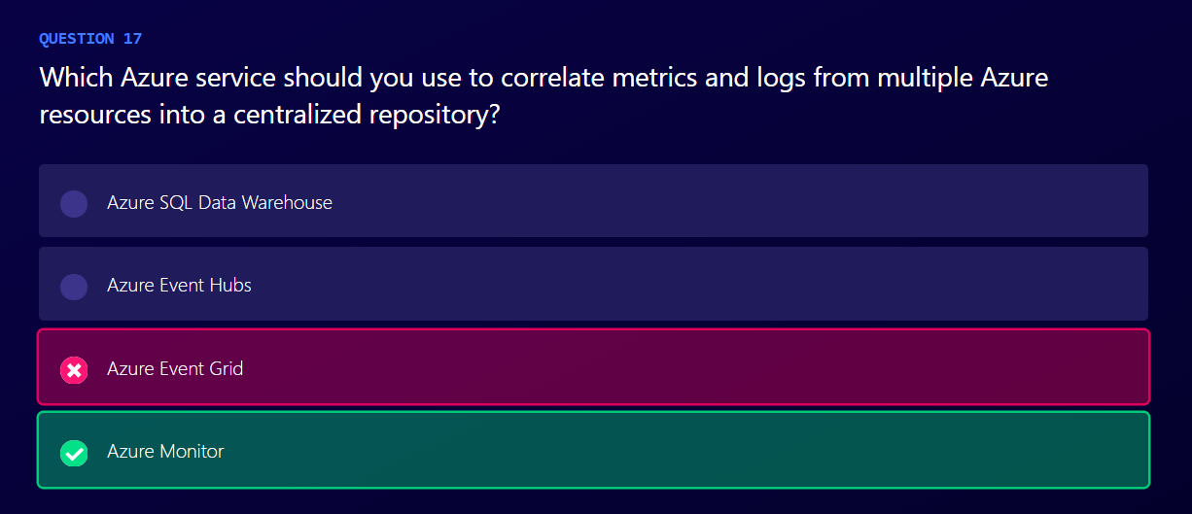
Notes:
Log data collected by Azure Monitor (formerly Azure Log Analytics) is stored in a Log Analytics workspace, which is based on Azure Data Explorer. It collects telemetry from a variety of sources and uses the Kusto query language used by Data Explorer to retrieve and analyze data.

Slide 45
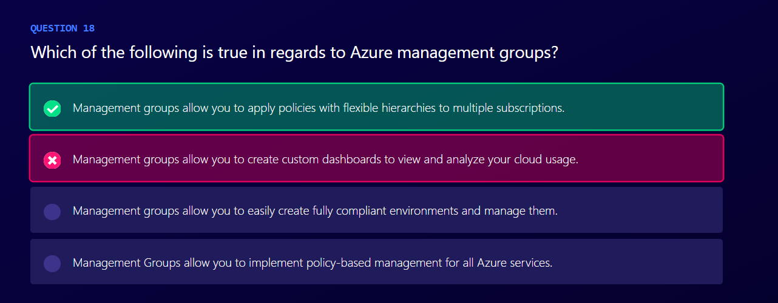
Notes:
Azure management groups provide a level of scope above subscriptions. You organize subscriptions into containers called management groups and apply your governance conditions to the management groups. For example, you can apply policies to a management group that limits the regions available for virtual machine (VM) creation.

Slide 46
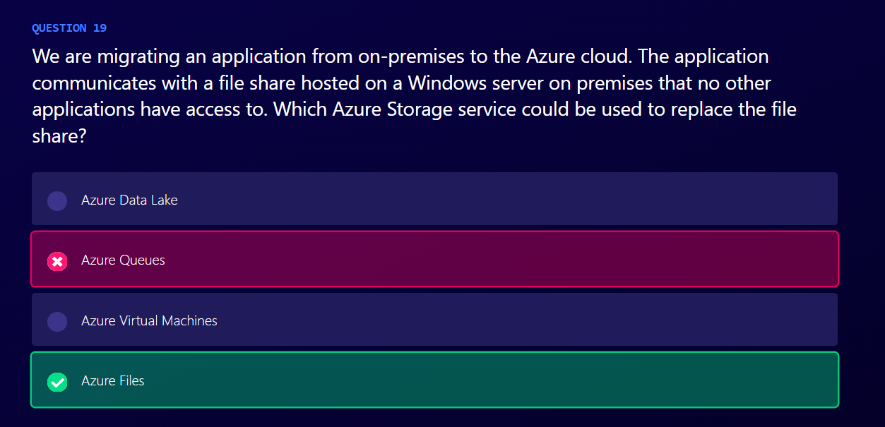
Notes:
Azure Files can be used to house the migrated Windows file share data.

Slide 47
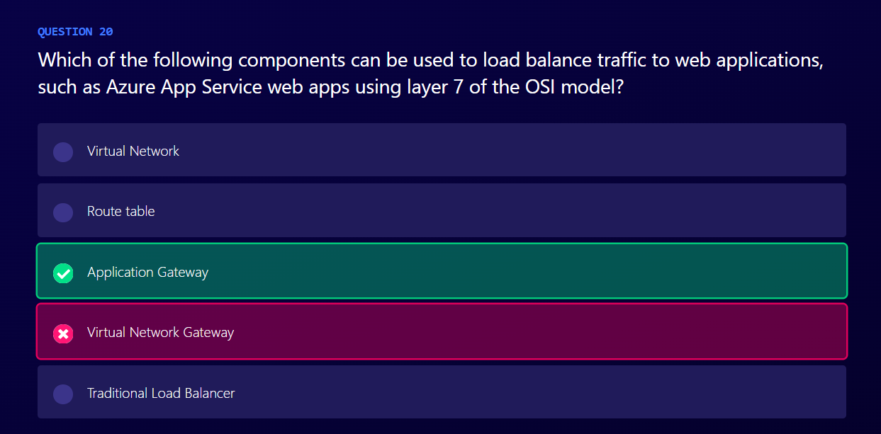
Notes:
Azure Application Gateway is a web traffic load balancer that enables you to manage traffic to your web applications. They are aware of the much more abstract high-level layer 7 in the OSI model, meaning the load balancer understands HTTP headers and can do things such as routing requests to different places based on the URL of a web request.

Slide 48
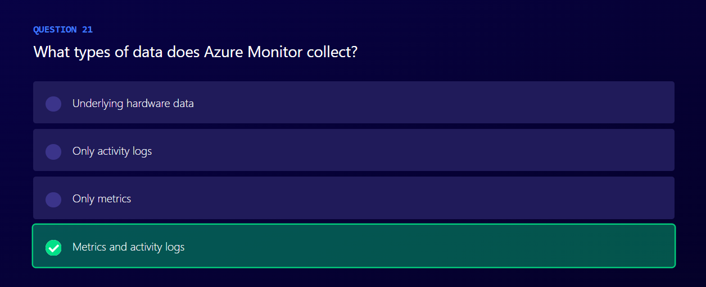
Notes:
Azure Monitor collects two broad types of data: metrics and logs. Within these data types sits subscription monitoring data. Physical hardware data is not collected by Azure Monitor.

Slide 49
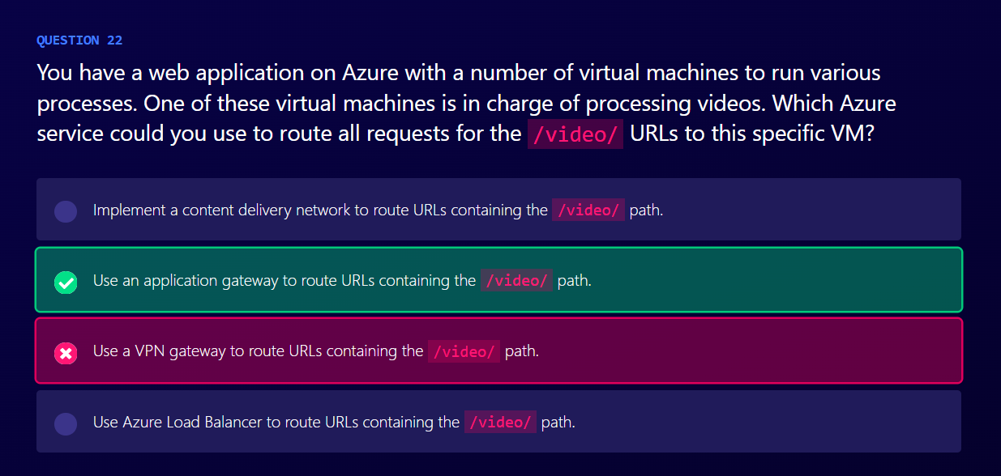
Notes:
An application gateway is used specifically for routing traffic based on parameters in the traffic itself. This could be all requests to the /video/ path of the URL being sent to a specific VM. A VPN gateway is used to securely connect an Azure virtual network with an on-premises network. A CDN does not route traffic. A load balancer routes all traffic without looking at it.

Slide 50
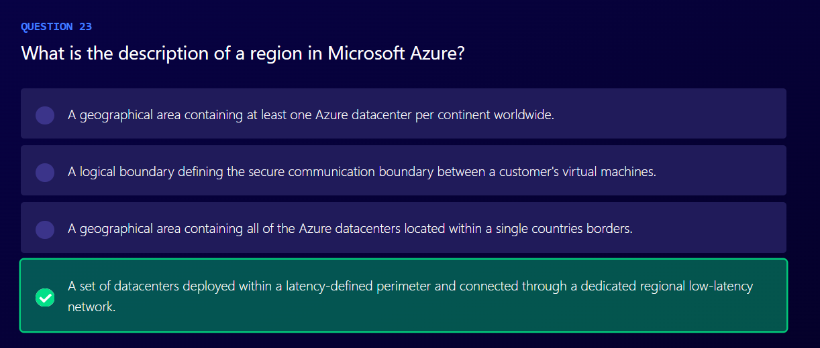
Notes:
An Azure region is a geographical area, usually around one part of a particular country, that comprises of one or more physical Azure datacenters connected together with very fast network connections. Regions can span across multiple countries (such as the East Asia region), and there can be more than one region per country (the US has over a dozen regions). A logical boundary for secure communication would usually refer to a VNet (a virtual network).

Slide 51
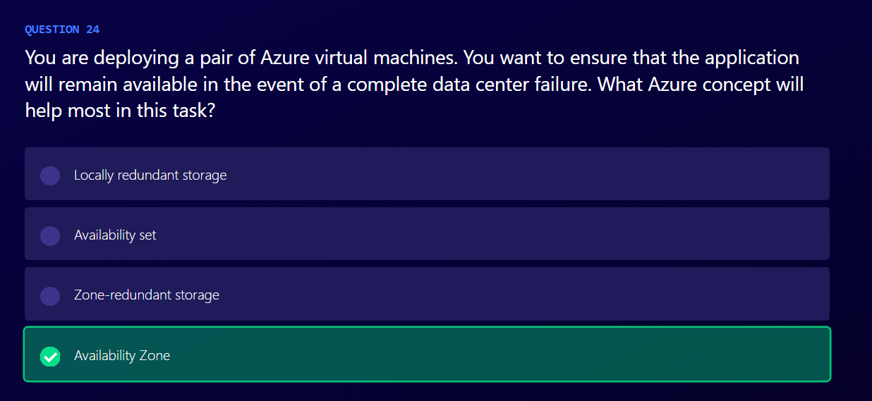
Notes:
Each Availability Zone is made up of one or more datacenters equipped with independent power, cooling, and networking within an Azure region. Configuring your virtual machines in distinct Availability Zones ensures that only a subset of the virtual machines in an Availability Zone will be affected in the event of hardware failure, OS update, or a complete datacenter outage. This configuration offers 99.99% SLA.

Slide 52
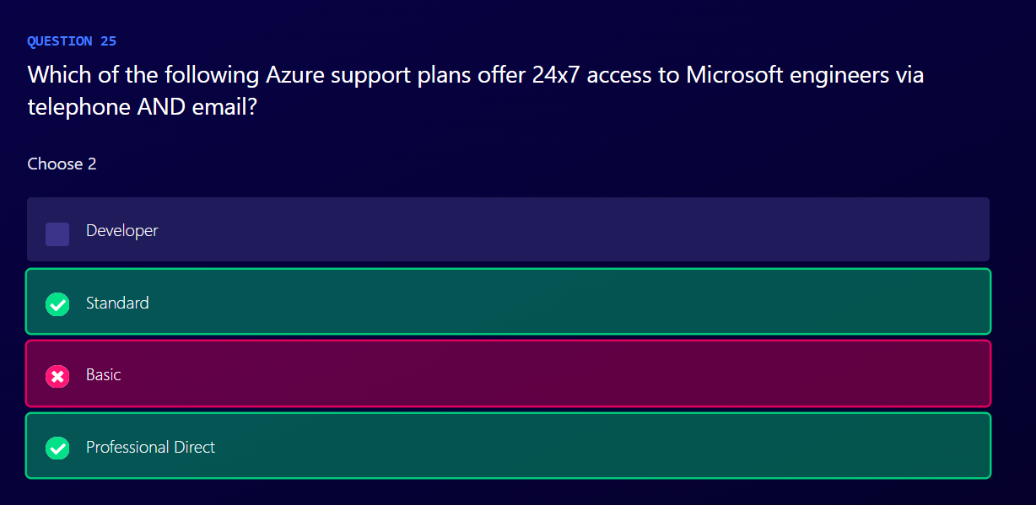
Notes:
The Standard support plan offers 24x7 access to Microsoft support engineers via telephone and email.
The Professional Direct support plan offers 24x7 access to Microsoft support engineers via telephone and email.

Slide 53
Thank you!

